Slide 1



SRI KRISHNA ARTS AND SCIENCE COLLEGE
Kuniamuthur, Coimbatore 641-008
DEPARTMENT OF COMPUTER TECHNOLOGY & DATA SCIENCE
FINAL YEAR PROJECT
NAME : HAFIL A
DEPT : B.Sc. COMPUTER TECHNOLOGY
REG NO : 22BCT017
GUIDE NAME:
Ms. S. Srisowmiya, M.Sc.,

Slide 2
ORGANISATION PROFILE
LIVE STREAM Technologies (LST) is a software development company headquartered in Coimbatore, India. The cornerstone of the company's outsourcing strategy is a balancing combination of onsite presence and service delivery.
LST is a leading software development company, that is into customized software applications, and website development services based on a range of platforms and technologies.
LST provides services like Web designing, Application Development, and Maintenance Outsourcing services that lead to business process improvement. This allows for the reduction of costs and enables business growth. LST’s Application Development and Maintenance Services is part of its IT Services Group

Slide 3

COMPANY ACCEPTANCE LETTER

Slide 4

PROJECT COMPLETION CERTIFICATE

Slide 5
ABSTRACT
Image Classification using CNN is a deep learning-based project that classifies
images into different categories using Convolutional Neural Networks (CNNs). CNNs are widely used for image recognition tasks due to their ability to capture spatial hierarchies in images. This project is trained on the CIFAR-10 dataset, which consists of 60,000 images across 10 classes, enabling the model to classify images with high accuracy.
This project is implemented using Python, PyTorch, and Flask. The CNN model is trained from scratch using PyTorch, leveraging data augmentation techniques to enhance generalization. Once trained, the model is deployed in a Flask-based web application, allowing users to upload images and receive real-time classification results. The web application is designed with a modern UI, ensuring an interactive and seamless experience for users

Slide 6
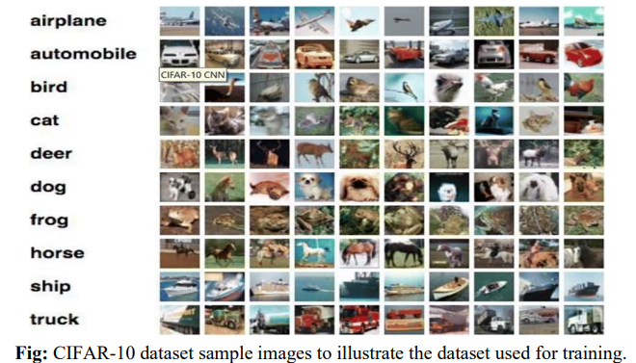

Slide 7
SOFTWARE REQUIREMENTS:
• Operating System: Windows
• Platform: Visual Studio Code and Flask
• Programming Language: Python 3.8+
• Libraries & Frameworks: Deep Learning: PyTorch, Torchvision, Data Handling: NumPy, Pandas, Image Processing: OpenCV, PIL (Pillow), Visualization: Matplotlib, Seaborn, Model Interpretation: Grad-CAM Web Framework: Flask
HARDWARE REQUIREMENTS:
Processor: Intel i3
Processor Speed : 250MHz to 667 MHz
RAM: 8 GB
Hard Disk: 250 GB
Keyboard: Standard 104 enhanced keyboard

Slide 8
EXISTING SYSTEM
Traditional image classification methods relied on handcrafted features and classical machine learning algorithms, such as Support Vector Machines (SVM), k-Nearest Neighbors (k-NN), and Decision Trees. These models required extensive manual feature extraction techniques, including edge detection, color histograms, and texture analysis. While these methods worked well for simpler tasks, they struggled with high-dimensional and complex image datasets, often failing to capture intricate spatial features.
Another limitation of existing methods was their inability to adapt to variations in lighting, angles, backgrounds, and object distortions. Classical approaches lacked the ability to generalize well across different datasets, leading to poor performance on unseen images. Additionally, traditional systems required large amounts of domain expertise to manually design feature extractors, making them time-consuming and inefficient.

Slide 9
PROPOSED SYSTEM
To overcome the limitations of traditional approaches, this project implements an advanced deep learning-based image classification system using Convolutional Neural Networks (CNNs). Unlike conventional methods, CNNs automatically learn spatial hierarchies of features through multiple layers of convolutions, pooling, and activation functions. This eliminates the need for manual feature extraction and significantly improves classification accuracy.
The proposed system is trained on the CIFAR-10 dataset, which consists of 60,000 labelled images divided into 10 distinct categories. The CNN architecture is carefully designed with multiple convolutional layers, ReLU activation functions, dropout layers, and batch normalization to optimize feature extraction and generalization. Additionally, data augmentation techniques such as random cropping, horizontal flipping, and brightness adjustments are applied to enhance the model’s robustness against variations in input images.
To improve interpretability, the system integrates Grad-CAM (Gradient-weighted Class Activation Mapping), allowing users to visualize important regions in an image that contribute to classification decisions. This enhances transparency and ensures that the model’s predictions can be understood and validated.

Slide 10
MODULE DESCRIPTION
This system consists of several key modules designed to efficiently classify images using CNN. Below are the main modules:
• Image Pre-processing Module
• CNN Model Training & Evaluation Module
• Prediction & Classification Module
• Grad-CAM Visualization Module
• Web Interface Module (Flask)

Slide 11
Image Preprocessing Module The image pre-processing module prepares input images for training and classification. The system applies several pre-processing techniques: • Resizing: Converts all images to 32x32 pixels for CNN compatibility. • Normalization: Scales pixel values to the range [0,1]. • Data Augmentation: Uses transformations like flipping, rotation, and cropping to enhance model generalization. • Splitting Data: Divides dataset into training (80%) and testing (20%) sets. These pre-processing steps improve model accuracy and robustness. CNN Model Training & Evaluation Module The CNN model training module is responsible for developing the deep learning model. It follows these steps: • Defines CNN architecture using Conv2D, MaxPooling2D, Flatten, Dense, and Dropout layers. • Trains model using the CIFAR-10 dataset with a suitable loss function (categorical cross entropy). • Optimizes training using an optimizer like Adam or SGD. • Evaluates performance using accuracy, loss graphs, and confusion matrix. The trained model can be saved and reloaded for future predictions.
MODULE DESCRIPTION

Slide 12
Prediction & Classification Module This module handles real-time image classification. When a user uploads an image, the system: • Pre-processes the input image (resizing, normalization). • Passes it through the trained CNN model. • Predicts the most likely class and displays the result along with the confidence score. Grad-CAM Visualization Module The Grad-CAM (Gradient-weighted Class Activation Mapping) module provides model interpretability. It: • Generates heatmaps that highlight important regions in the image. • Helps users understand why the CNN made a particular prediction. • Improves trust and transparency in model decisions. Web Interface Module (Flask) • Provides a frontend for users to upload images. • Sends images to the backend (CNN Model) for classification. • Displays prediction results to the user.
MODULE DESCRIPTION

Slide 13
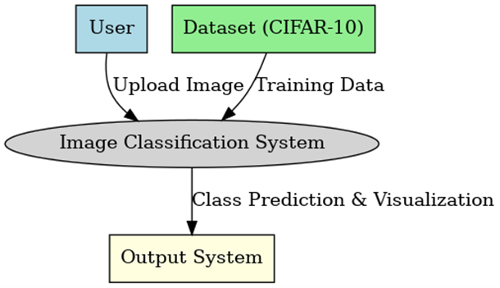
DATA FLOW DIAGRAM
DESIGN
DFD LEVEL 0

Slide 14
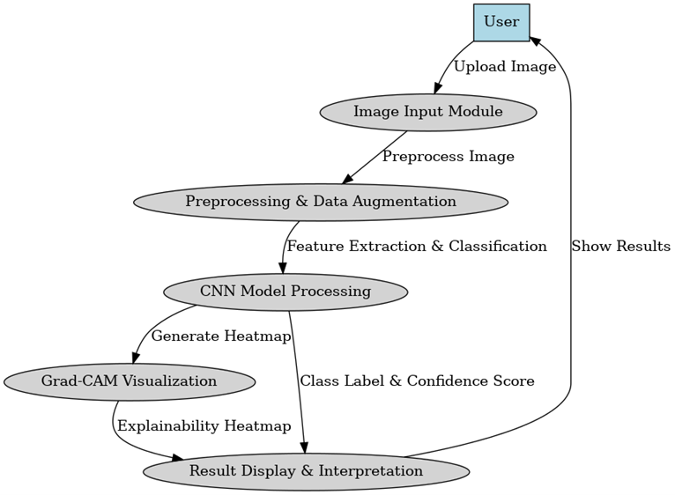
DFD LEVEL 1

Slide 15
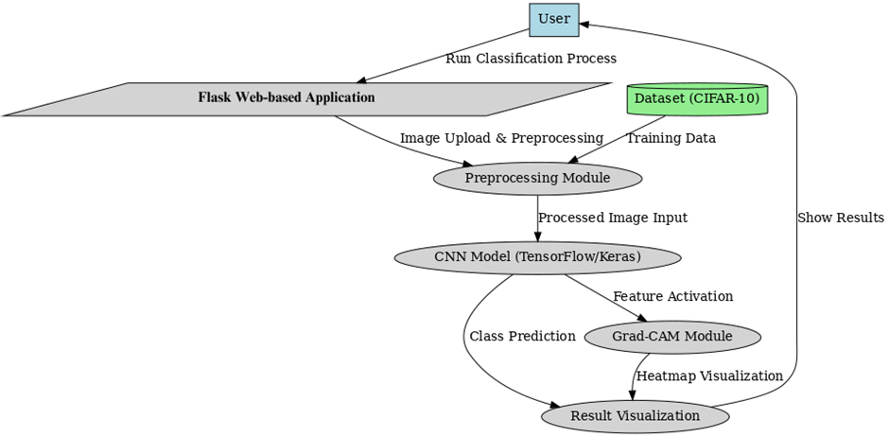
SYSTEM ARCHITECTURE DIAGRAM

Slide 16
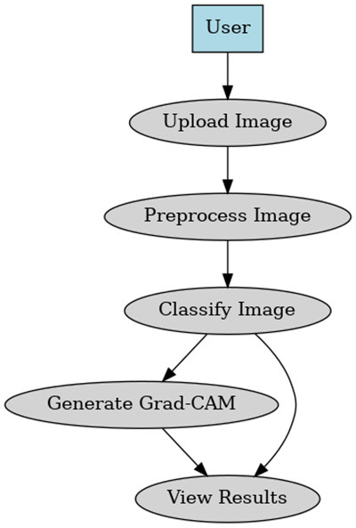
USE CASE DIAGRAM
c

Slide 17
SYSTEM TESTING IMPLEMENTATION
TESTING:
Testing is a process used to help identify the correctness, completeness and quality of developed computer software. With that in mind, testing can never completely establish the correctness of computer software. Testing helps is verifying and Validating if the Software is working as it is intended to be working. This involves using Static and Dynamic methodologies to Test the application.
Testing Activities
There are five main activities in the Testing Discipline. The five activities apply to each phase of testing: unit, integration, regression, and acceptance. There are specific modules for each process at a unit test level, as well as module for integration, regression, and acceptance testing. Each testing activity applies to both implementation and ongoing teams.

Slide 18
TYPES OF TEST CARRIED:- In our application, we are performing the Gary Box testing (white and black). WHITE BOX TESTING White Box Testing mainly focuses on the internal performance of the Complaints. Here apart will be taken at a time and tested thoroughly at a statement level to find the maximum possible errors. Also, construct a loop in such a way that the part will be tested within a range. That means the part is executed at its boundary values and within bounds for the purpose of testing. White Box Testing in this Project: I tested stepwise every piece of code, taking care that every statement in the code is executed at least once. I have generated a list of test cases, and sample data, which is used to check all possible combinations of execution paths through the code at every module level.

Slide 19
BLACK BOX TESTING This testing method considers a module as a single unit and checks the unit at interface and communication with other modules rather than getting into details at the statement level. Here the module will be treated as a block box that will take some input and generate output. Output for a given set of input combinations is forwarded to other modules. Black Box testing in this Project: I tested each and every module by considering each module as a unit. I have prepared some sets of input combinations and checked the outputs for those inputs. Also, I tested whether the communication between one module and to other module is performing well or not. VALIDATION TESTING: The system has been tested and implemented successfully and thus ensured that all the requirements as listed in the software requirements specification are completely fulfilled. Validation helps in building the right complaints as per the user’s requirement and helps in satisfying their needs. Validation is basically done by the testers during the testing. In case of erroneous input corresponding error messages are displayed.

Slide 20
This section describes about the Implementation of the Safe application and the details of how to access this control from any application. Implementation is the process of assuring that the information system is operational and then allowing users take over its operation for use and evaluation. Implementation includes the following activities. - Obtaining and installing the system hardware. − Installing the system and making it run on its intended hardware. − Providing user access to the system. − Creating and updating the database. − Documenting the system for its users and for those who will be responsible for maintaining it in the future. − Making arrangements to support the users as the system is used. − Transferring ongoing responsibility for the system from its developers to the operations or maintenance part. − Evaluating the operation and use of the system.
SYSTEM IMPLEMENTATION:

Slide 21
CONCLUSION:
The Grievances Registration and Management System has been successfully developed with the needs and requirements of the company. The system is tested with intensive care for all possibilities of errors. The database in this system is maintained in a controlled manner to avoid all possible errors.
The system developed is very user friendly and there is no need for any special training with the software. All the data involved in this system can be viewed in the form of a report at any time. The reports are produced in such a way that satisfies the management to make certain decisions over the company management.

Slide 22
The “Grievances Registration and Management System” can be further developed into a separate, automated system with the following enhancements: More future work and knowledge are needed to further improve the performance of the opinion spam analysis. There is a huge need in the industry, in day-to-day life for such applications because every company wants to know how consumers really feel about their products and services and those of their competitors by analyzing true reviews, not spam reviews. This research proposes an opinion spam analyzer that automatically classifies input text data into either spam or non-spam categories. A direction for future research is to implement the system and check performance by applying the proposed approach to various benchmark data sets. Comparing the performance of different classification methods to find the best one for our proposed opinion spam classification method could be another future research direction. However, there exist other kinds of review or reviewer-related features that are likely to make a contribution to the prediction task. In the future, we will further investigate different kinds of features to make more accurate predictions
FUTURE ENHANCEMENT

Slide 23
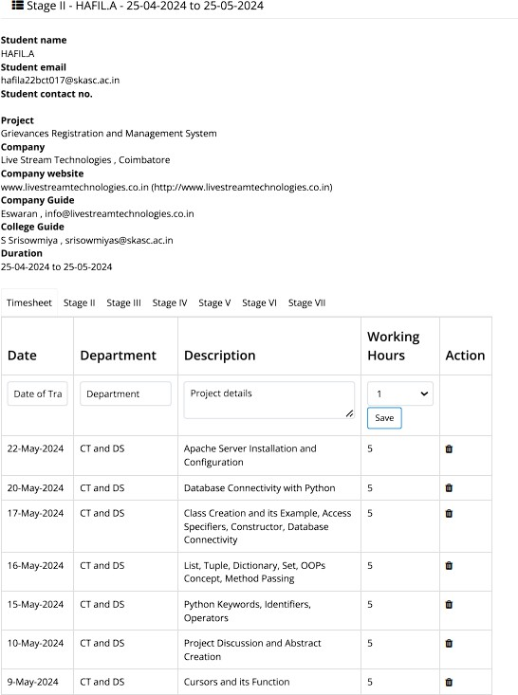
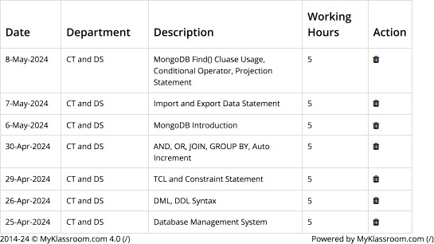
TIMESHEET

Slide 24

SCREENSHOTS
HOME PAGE:

Slide 25
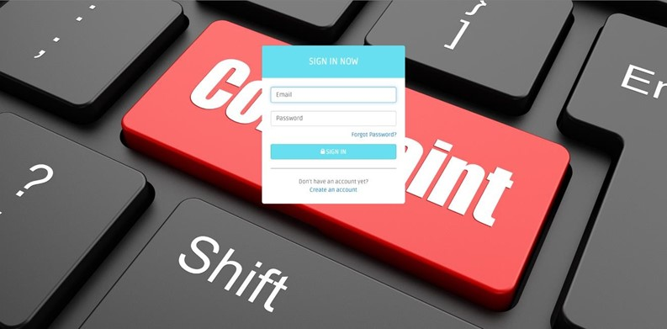
USER LOGIN PAGE:

Slide 26
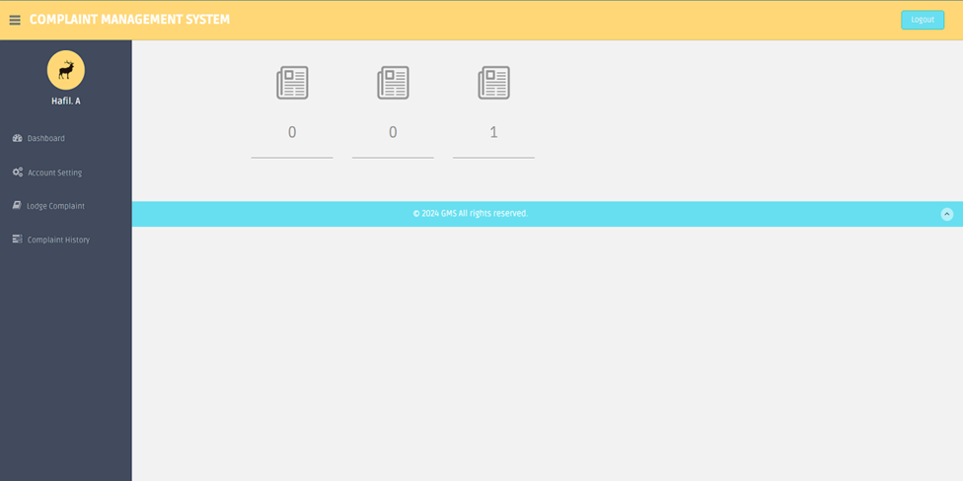
USER DASHBOARD PAGE:

Slide 27
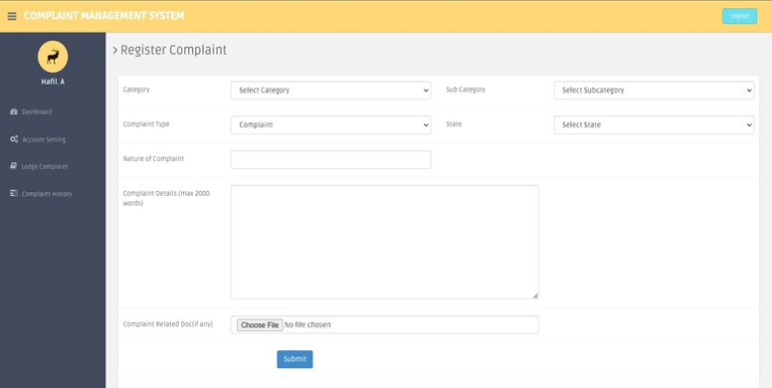
USER LODGE COMPLAINT PAGE:

Slide 28
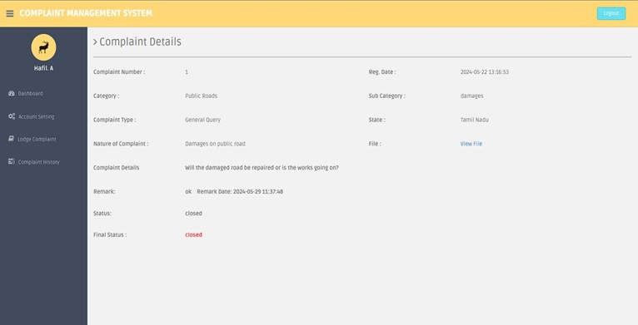
USER COMPLAINT HISTORY PAGE:

Slide 29
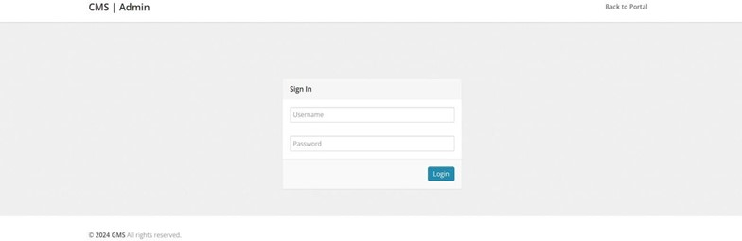
ADMIN PAGE:

Slide 30
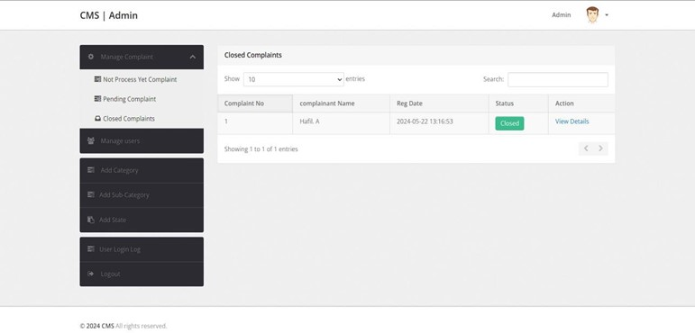
ADMIN DASHBOARD PAGE:

Slide 31
THANK YOU

